Slide 1
Credit Card Fraud
13 November, 2023

Slide 2
Credit card fraud leads to large financial losses
In the U.S.-
In 2022, $8.8 billion losses due to fraud
At our company-
In 48 months, >8000 fraudulent transactions cost >$843,000
Our goal: flag and prevent fraudulent transactions to protect our company from losses without inconveniencing customers
Notes:
Between … and …

Slide 3
Dataset
0.12%
Transactions are fraudulent
4 years: 2015-2019
6,877,837 transactions
1610 users (users ≠ persons)
Missing data: Merchant zipcode, transaction count, errors
Created columns: Geographical difference between purchaser and purchase, days to card expiration
Random sampled a subset of 50% for initial tests
Notes:
None of the transactions in my subsample were on the dark web, and none were…

Slide 4
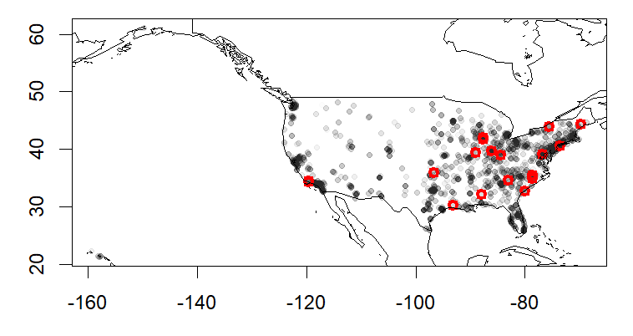
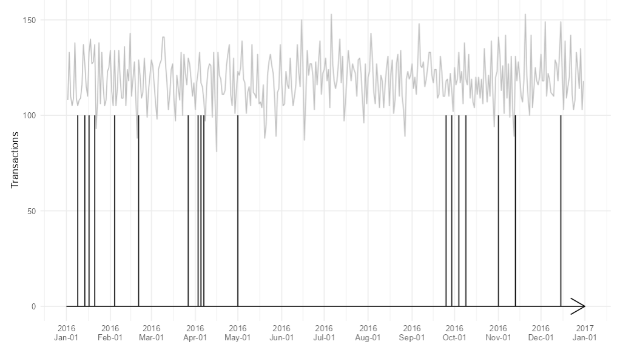
Where does fraud occur?
And when?
Fraud is not necessarily more frequent in locations where more users live.
Fraud is not necessarily more frequent when transactions increase.

Slide 5
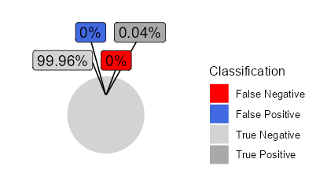
Alerting for fraudulent transactions
Attempted penalized logistic regression using Elastic Net (failed to converge)
Simulated data by adding randomized error to true fraud
Can tune probability threshold of model to reduce false positives or false negatives
Notes:
(suspicious, non-fraudulent transactions) (permitted fraudulent transactions)

Slide 6
Demonstrate Probability Cut-off
Notes:
Can also change date, some windows of time have fewer fraudulent transactions
Accuracy, Precision, Type I or Type II Errors by month, + pie chart

Slide 7
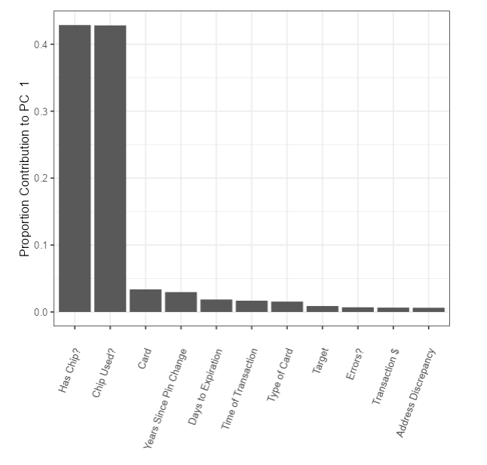
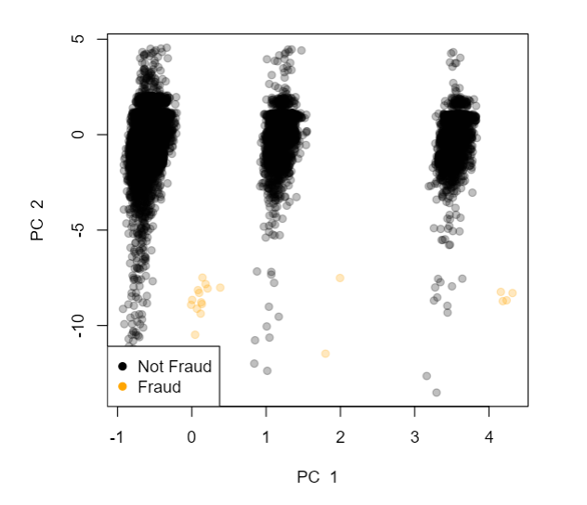
Diagnostic features of fraudulent transactions
Many potential strategies for anomaly detection
Density-based clustering (DBSCAN): gold standard
PCA: recoded factor columns as binary and scaled
PC identified most impactful transaction features:
Chip
Card Number
Charge-off (but dropped)

Slide 8
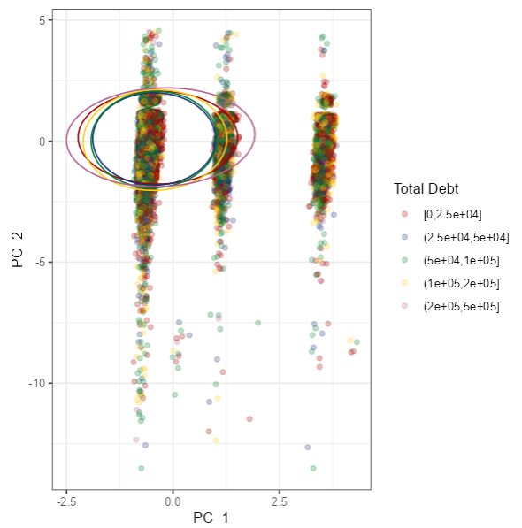
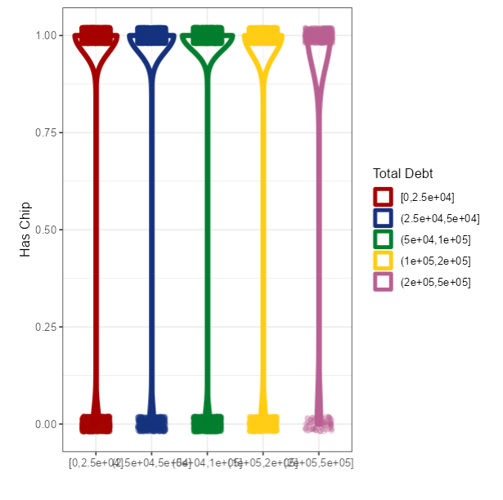
Customer features associated with fraud
After identifying features of transactions associated with fraud, I compared to customer descriptors
Customers with high debt tend to have chip cards, but this does not seem to be associated with fraudulent transactions
Notes:
Fraud is very, very small, so statistics were hard.
Older folks were slightly more likely to be targeted? Also recent changes in pin matter!

Slide 9
Dashboard Walkthrough

Slide 10
Take-away:
Can find diagnostic features of fraudulent transactions

